Slide 1
Overall AKS
Review
FIFTH GRADE

Slide 2
01
02
COMMUNITY
AGREEMENTS
03
04
05
Stay engaged and participate.
Provide opportunities for voice
equity.
Show grace and patience.
Be vulnerable and take a risk.
Keep students at the forefront.

Slide 3
GCPS VISION FOR MATHEMATICS
To develop students into confident and competent mathematical problem solvers who have a deep conceptual understanding of numbers, can compute, think critically, and communicate their thoughts and mathematical reasoning effectively.

Slide 4

BIG BUCKETS
4 BIG IDEAS (DOMAINS)
STANDARDS
Numerical Reasoning (NR)
Patterns & Algebraic Reasoning (PAR)
Geometric & Spatial Reasoning (GSR)
Measurement & Data (MDR)
-Data and Statistical Reasoning is
embedded
AKS (6 to 8 per grade)
Indicators of Achievement
-Advanced Content
-Differentiated Instruction
Grades 3-5 Extensions

Slide 5
MATHEMATICAL PRACTICES
HOW TO BE A MATH PERSON:
5.MP: Demonstrate skills and strategies needed to succeed in mathematics, including perseverance, patient problem-solving, critical thinking, reasoning and sense-making, effective collaboration, and expression. Seek help and apply feedback. Set and monitor goals.
Make sense of problems and persevere in solving them.
Reason abstractly and quantitatively.
Construct viable arguments and critique the reasoning of others.
Model with mathematics.
Use appropriate tools strategically.
Attend to precision.
Look for and make use of structure.
Look for and express regularity in repeated reasoning.

Slide 6
2023-2024 AKS
5MA.A.1 | use place value understanding to solve real-life, mathematical problems (5.NR.1)
5MA.A.2 | multiply and divide multi-digit whole numbers to solve relevant, mathematical problems (5.NR.2)
5MA.A.3 | describe fractions and perform operations with fractions to solve relevant, mathematical problems using part-whole strategies and visual models (5.NR.3)
5MA.A.4 | read, write, and compare decimal numbers to the thousandths place; round decimal numbers to the hundredths place; add and subtract with decimal numbers to the hundredths place to solve relevant, mathematical problems (5.NR.4)
5MA.A.5 | write, interpret, and evaluate numerical expressions within authentic problems (5.NR.5)
5MA.B.6 | solve relevant problems by creating and analyzing numerical patterns using the given rule(s) (5.PAR.6)
5MA.C.7 | solve problems involving customary measurements, metric measurements, and time and analyze graphical displays of data to answer relevant questions (5.MDR.7)
5MA.D.8 | examine properties of polygons (e.g., triangles, quadrilaterals including kites, trapezoids, rectangles, squares, rhombuses, other parallelograms, pentagons, hexagons, octagons) and rectangular prisms; classify polygons by their properties; discover volume of right rectangular prisms (5.GSR.8)

Slide 7

LET’S COLLABORATE!
MATERIALS:
DIRECTIONS:
Last year’s AKS
NEW 2023-2024 AKS and IOAs
Cards
Chart Paper
Markers
Glue Sticks
Read through the AKS/IOA cards
Determine if the AKS/IOA is:
  New to 5th Grade
  Same as last year
  Same, but with a twist
Design a way to share this information on the chart paper

Slide 8
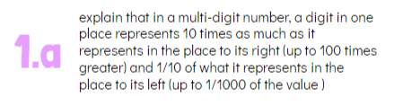

AKS: 5MA.A.1
NEW to 5th Grade | Same as Last Year | Same, but with a Twist
Use place value understanding to solve real-life, mathematical problems

Slide 9




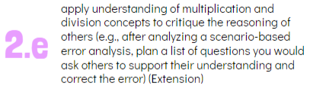
AKS: 5MA.A.2
NEW to 5th Grade | Same as Last Year | Same, but with a Twist
Multiply and divide multi-digit whole numbers to solve relevant, mathematical problems

Slide 10
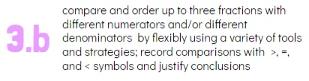
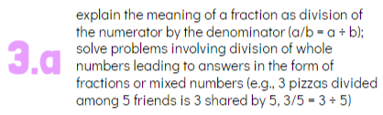




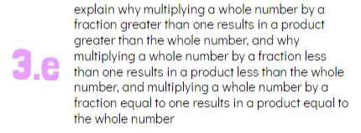
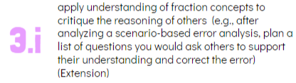


AKS: 5MA.A.3
NEW to 5th Grade | Same as Last Year | Same, but with a Twist
Describe fractions and perform operations with fractions to solve relevant, mathematical problems using part-whole strategies and visual models

Slide 11

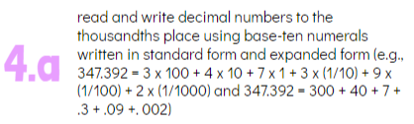




AKS: 5MA.A.4
NEW to 5th Grade | Same as Last Year | Same, but with a Twist
Read, write, and compare decimal numbers to the thousandths place; round decimal numbers to the hundredths place; add and subtract with decimal numbers to the hundredths place to solve relevant mathematical problems

Slide 12
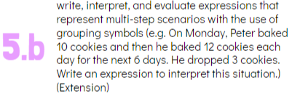

AKS: 5MA.A.5
NEW to 5th Grade | Same as Last Year | Same, but with a Twist
Write, interpret, and evaluate numerical expressions within authentic problems

Slide 13



AKS: 5MA.B.6
NEW to 5th Grade | Same as Last Year | Same, but with a Twist
Solve relevant problems by creating and analyzing numerical patterns using given rule(s)

Slide 14





AKS: 5MA.C.7
NEW to 5th Grade | Same as Last Year | Same, but with a Twist
Solve problems involving customary measurements, metric measurements, and time and analyze graphical displays of data to answer relevant questions

Slide 15
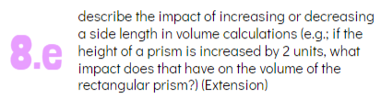



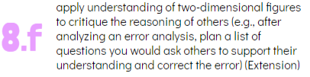


AKS: 5MA.D.8
NEW to 5th Grade | Same as Last Year | Same, but with a Twist
Examine properties of polygons (specifically quadrilaterals) and rectangular prisms; classify polygons by properties; discover volume of rectangular prisms

Slide 16
OPTIMISTIC CLOSING
What nugget of information do you want to remember after today’s learning?
BYE!

