Slide 1
Implementing Instructional Conversation Pedagogy in the Math Classroom
Stephanie Guynn
Burnette Elementary

Slide 2
Instructional Conversation Model
“ The instructional Conversation (IC) pedagogical model has had a statistically significant impact on student achievement in reading and other content areas for all students in third and fifth grade. The effects are particularly strong for ELLs.”
Dr. Pedro Portes
Executive Director of CLASE
The Instructional
Conversation
Model

Slide 3
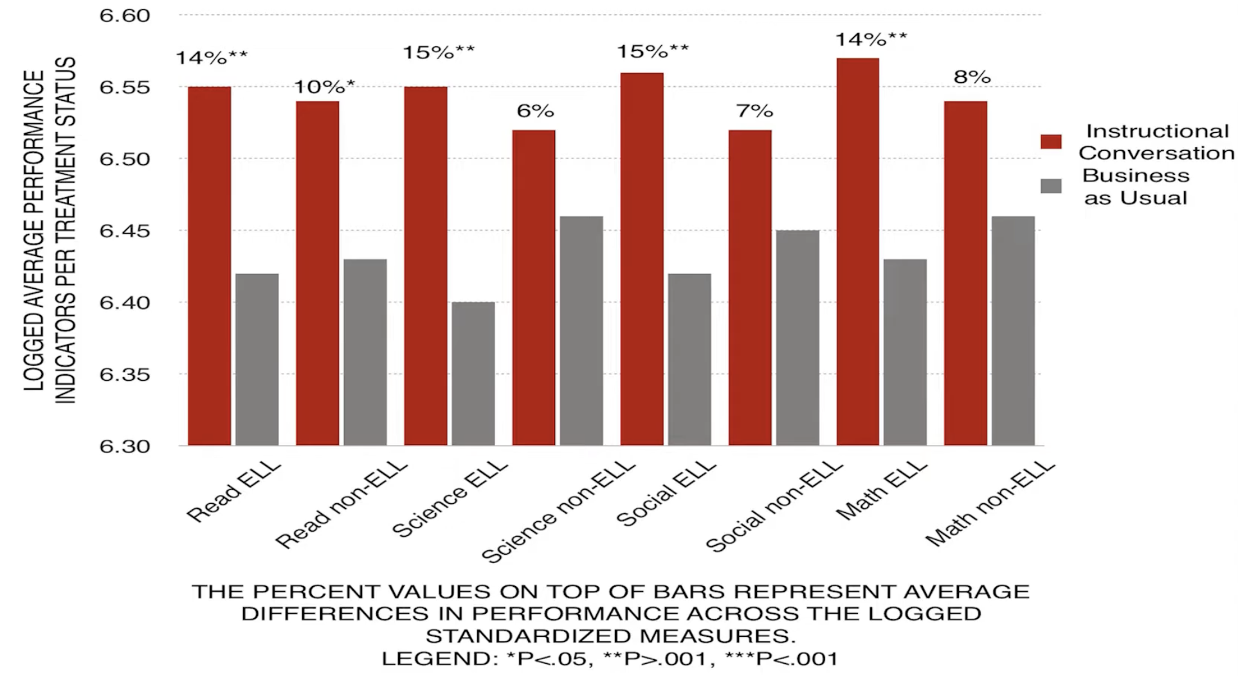
Overall Effects of Intervention

Slide 4
Standards of Effective Pedagogy
Collaborative Conversation-Based Instruction
Purposeful Conversation
Language & Literacy Development
Challenging & Complex Activities
Contextualization for Meaning

Slide 5
Instructional Conversation Means..
Teacher is there to facilitate. Students engage in respectful conversation back and forth, bouncing ideas off one another
Pinballing
NOT
The conversation should not follow teacher – student – teacher - student
Ping Ponging

Slide 6
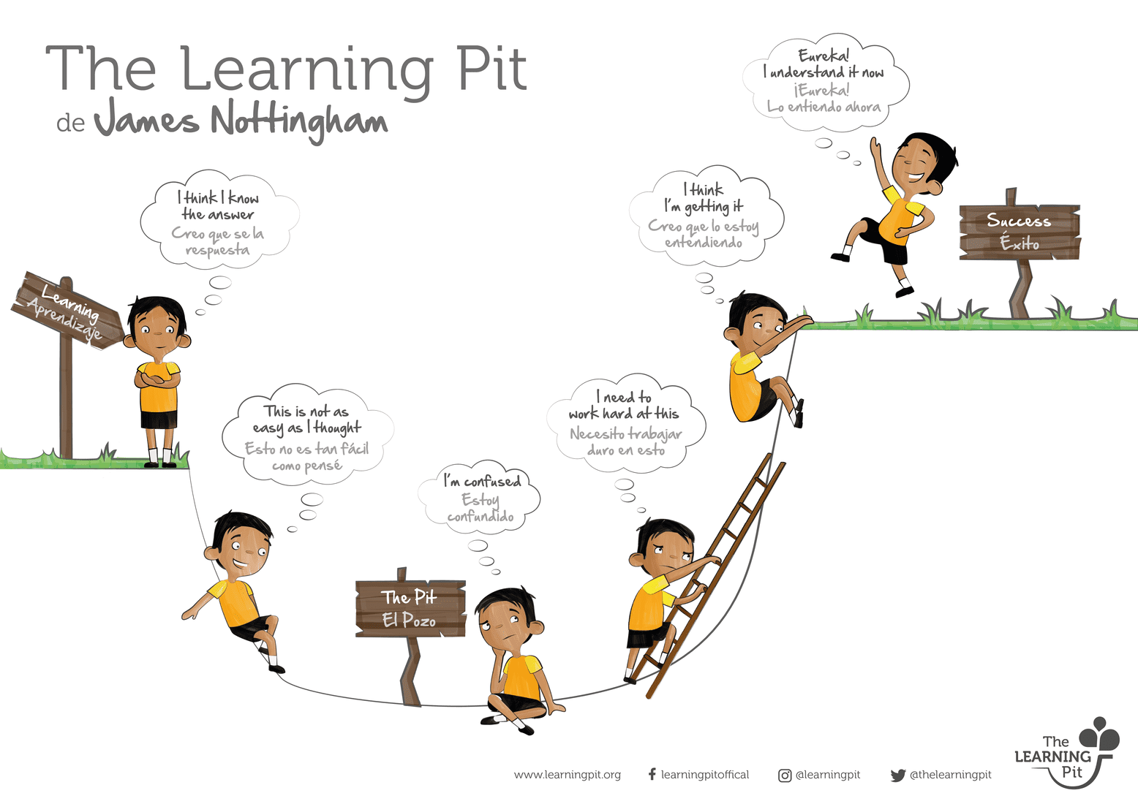
01
Facing a
Challenge
04
Deep
Learning
Having a Go
02
03
Problem Solving

Slide 7








Establishing Conversational Norms
GOOD LISTENERS
GOOD SPEAKERS
Listening ears
Use loud voices
Quiet mouths
Think first…
Then talk
Instructional
Conversation
Watching eyes
Have good eye contact
Still bodies
Thinking brains
Take turns

Slide 8
Mapping the Route to Contextualization
Level 4
04
Integrate what students share
Goals:
Change attitudes, actions, and activities
Promote students’ deeper conceptual understanding
Level 3
03
Create opportunities to learn about students from how they think
Level 2
02
Deliberately find shared knowledge to add to curriculum
Level 1
01
Recognize student’s context/individual differences
Level 0
00
Traditional Teacher Led Classroom

Slide 9
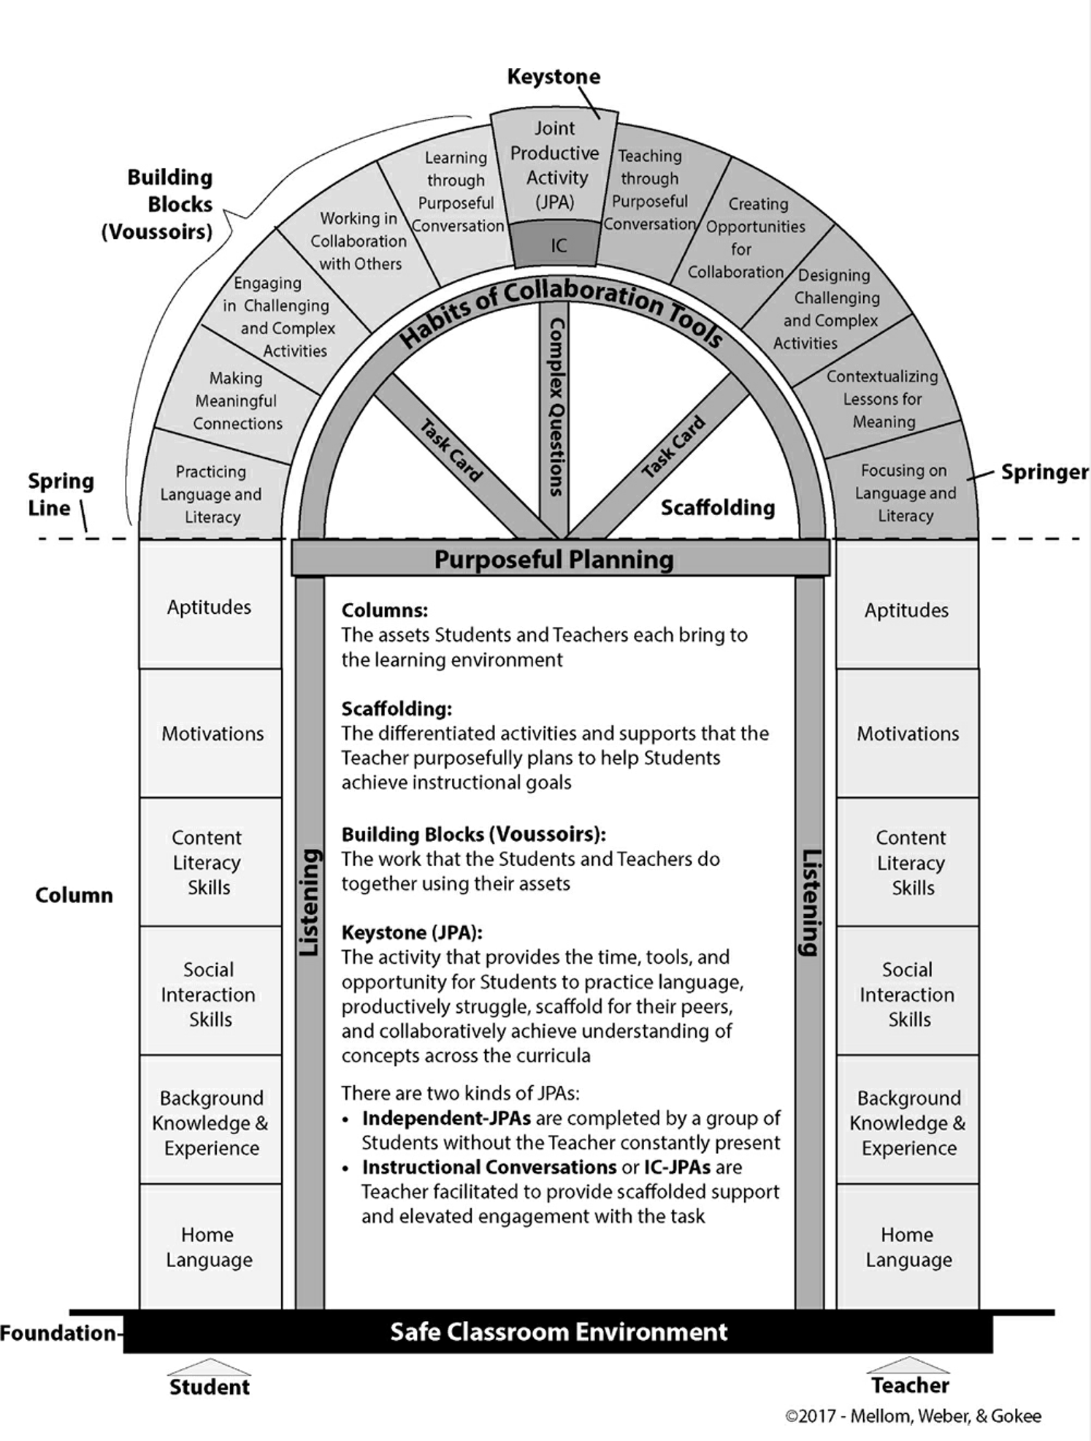
Arch of Collaborative Conversation-Based Instruction
Placing the Keystone:
Designing the Joint Productive Activity
Integrating Voussoir Blocks:
Enacting Meaningful, Complex, Collaborative, Conversation-Based Lessons
Framing Scaffolding:
Providing Differentiated Support
Building Columns:
Assessing & Capitalizing on Teachers’ & Students’ Assets
Laying the Foundation:
Safe Classroom Environment

Slide 10
Instructional Conversation Model
“Classroom environments that foster a sense of community that allows students to express their mathematical ideas—together with norms that expect students to communicate their mathematical thinking to their peers and teacher, both orally and in writing— positively affect participation and engagement among all students.”
NCTM 2014
The Instructional
Conversation
Model

Slide 11
Connecting Mathematical Content
01 | Focus on
 | students’ mathematical reasoning, not accuracy of language
02 | Shift to practices
 | that support mathematical discourse and move away from simplified view of language
03 | Recognize the complexity
 | of language in math classrooms and support student engagement
04 | Treat everyday language
 | as experiences and resources, not obstacles
05 | Uncover the mathematics
 | in what students say and do
Moschkovich, 2008

Slide 12
Tiered Terminology Model
Tier 1 – Conversational Terms
Tier 2 – Academic Terms
Tier 3 – Domain Specific Terms
Part of conversational language
Appear primarily in context (present challenge if MLLs are unfamiliar with context for cultural reasons)
High-utility terms
Academic verbs or prompts (i.e.- determine, evaluate)
Not usually part of conversational language
Domain specific (only encountered in math class)
I.E. – hypotenuse, addend
Vs
Vs
Beck, McKeown, & Kucan, 2013

Slide 13
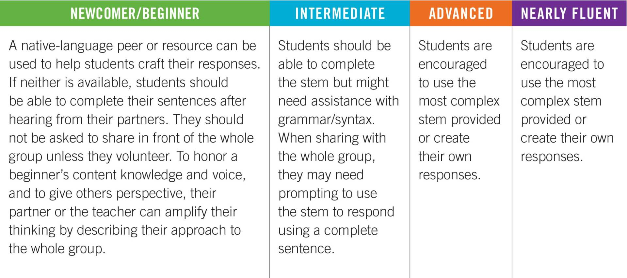
Teaching Math to Multilingual Learners
Table describing how to modify instruction for different levels of English fluency. (Courtesy of Seidlitz Education.)

Slide 14

Conversations in Math
Question
Stem
Provide sentence stems
Present class with a problem
to get the students ready to share their ideas:
“In my head, I saw…”
“My first step was…”
“I noticed…”
Ask the class a question seeking ideas about solving the math problem
Share
Signal
Provide thinking time
students share their responses
while students work on the math problem. Ask students to give you a response signal when they are ready to answer the question
with other students in pairs, triads, or groups (helps students to practice conversational and domain specific vocabulary)
Assess:
Determine the quality
of student discussions and the level of understanding of math concepts, not accuracy of language

Slide 15
Supporting Multilingual Learners
Support
01
02
Encourage
and expect mathematical competence in your ML students
“low-stakes” participation and practice in the classroom
Teach vocabulary
03
Present math concepts
04
before teaching math concepts
visually first, then use new vocabulary
Focus specifically
05
06
Connect with
ML for business
with real-world experiences
On the language of word problems

